Slide 1

Beyond the Books: Emotional Intelligence as a Key to Student Success
Unlocking the Power of Emotional Awareness in Higher Education
“Education is not the filling of a pail, but the lighting of a fire.” – William Butler Yeats

Slide 2

Welcome & Objectives
Who I am : Nicole Presa, BA, CST
Program Director – Fortis College Houston
Clinical Mental Health Counseling Intern, CMIP
Why We’re Here:
Understand emotional intelligence (EI).
Explore how EI impacts student success.
Learn strategies to cultivate EI in higher ed.

Slide 3
Emotional Intelligence Defined
Definition:
Emotional intelligence is the ability to accurately perceive, understand, and express emotion; the ability to use emotion to effectively think and reason; and the ability to regulate one’s emotions (J. D. Mayer et al., 1999; J. D. Mayer & Salovey, 1997).
Five Core Components:
Self-awareness
Self-regulation
Motivation
Empathy
Social skills

Slide 4

Why Emotional Intelligence Matters
Academic Success – Reduce stress/ Improve Focus
Personal Growth – Fosters Resilience / Adaptability/ Self-Confidence
Interpersonal Success – Improves Teamwork, Communication

Slide 5

The Costs of Low Emotional Intelligence
Stress & Burnout
Poor Interpersonal Relationships
Emotional Outbursts or Decision Paralysis
Example: A student who struggled academically due to unmanaged stress and poor communication skills.

Slide 6
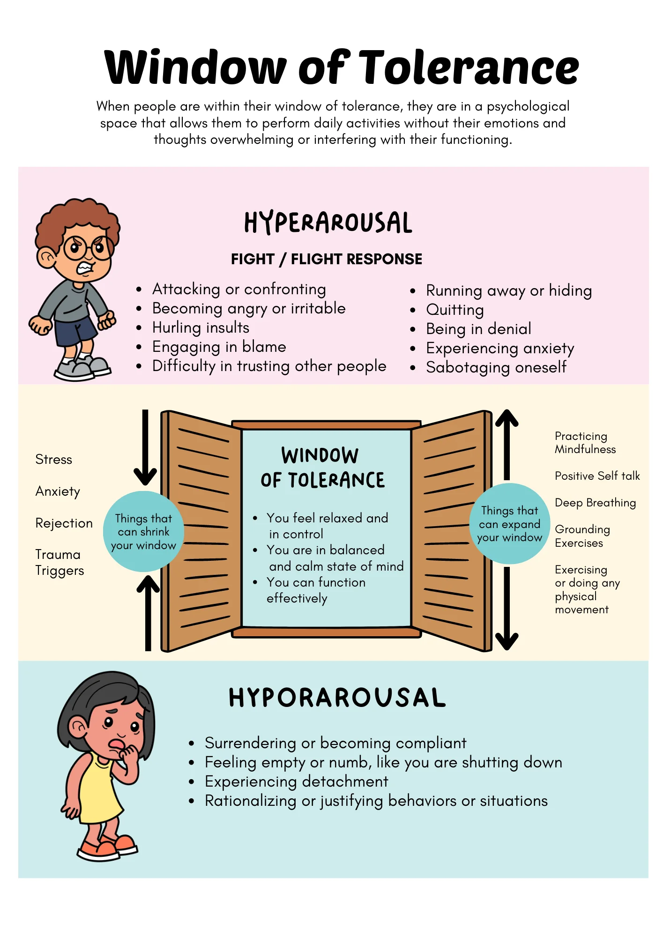
Understanding the Window of Tolerance
A concept that represents the range of emotions a person can comfortably manage without becoming overwhelmed.
Why It Matters:
Staying within the Window of Tolerance supports emotional regulation, focus, and learning.
(How to Understand and Stay within Your Window of Tolerance, n.d.)

Slide 7
Building Emotional Intelligence
For Students:
Practice mindfulness and reflection.
Regularly name and identify emotions.
Engage in empathy-building exercises.
For Educators:
Model emotional awareness in teaching.
Facilitate EI-focused activities or discussions.
Create safe spaces for emotional sharing.

Slide 8
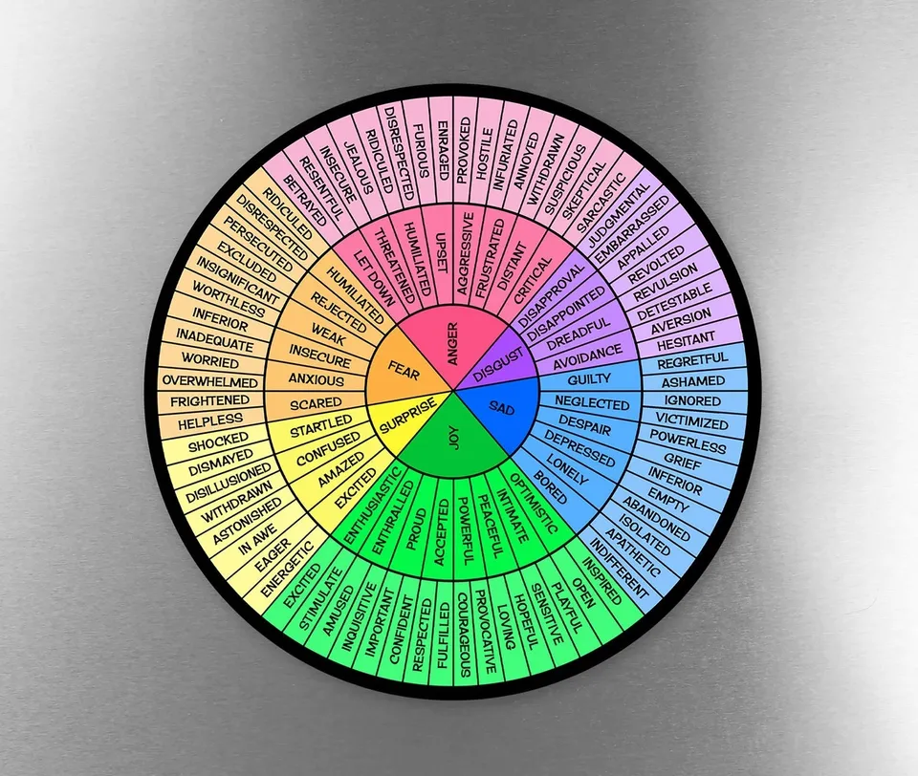
Expanding Emotional Awareness with the Feelings Wheel
What Is It?
The Feelings Wheel organizes emotions into primary, secondary, and tertiary levels to help people name and understand their feelings more deeply.
How It Supports EI:
Self-awareness: Identifies and names emotions.
Self-regulation: Helps recognize triggers for better management.
Empathy: Enhances understanding of others' emotional states.
Applications in Higher Ed:
Journaling exercises.
Emotional check-ins in group discussions.
Resolving conflicts by identifying core emotions.

Slide 9

The Elephant and the Rider: Balancing Emotion and Reason
Jonathan Haidt
The Metaphor:
  The Elephant Represents emotions, intuition, and unconscious drives.
  The Rider: Represents reason, logic, and conscious decision-making.
  The Challenge: The Rider may guide the Elephant, but the Elephant's size and strength make it challenging to control without alignment.
Why It Matters in Emotional Intelligence:
  EI helps the Rider understand and work with the Elephant.
  Recognizing when the Elephant is in control can help prevent impulsive reactions.
Application in Higher Ed:
  Helping students align their emotional drives (Elephant) with their academic goals (Rider).
  Teaching tools like mindfulness and self-regulation to balance the two.
  Elephant & Rider

Slide 10

Active Listening Skills for Teachers
Definition:
Active listening involves fully concentrating, understanding, and responding thoughtfully to others.
Key Skills:
Maintain eye contact to show attentiveness.
Use open body language to encourage dialogue.
Paraphrase to confirm understanding.
Avoid interrupting while the speaker shares.
Ask clarifying questions to deepen understanding.
Why It Matters:
Builds trust with students.
Promotes a space for emotional expression.
Helps uncover underlying emotions or concerns.

Slide 11

Practicing Active Listening
Scenario:
Split into pairs. One person shares a challenge they’ve faced in their teaching or learning environment, and the other practices active listening using the essential skills.

Slide 12
Active Listening
How did it feel to be actively listened to?
What was challenging about being the listener?

Slide 13

Putting EI Into Practice
Pause Before Reacting: Count to 10 when emotions run high.
Gratitude Practice: Start or end each day with a reflection on positive moments.
Perspective Taking: Regularly consider how others feel.
What would you do?
A typical scenario (e.g., a disagreement with an instructor).
What would an emotionally intelligent response look like?

Slide 14
Practicing Emotional Awareness
Scenario 1: A student feels unmotivated after receiving negative feedback on a paper.
What emotions might they be feeling?
Scenario 2: A student is nervous before a group presentation.
How could identifying their feelings help manage their stress?

Slide 16
Tracking Emotional Growth
Use self-assessments like journaling or feedback.
Focus on growth, not perfection.

Slide 17

Key Takeaways
EI is crucial for academic and personal success.
It’s a skill that can be nurtured with practice.
“Success is not the key to happiness. Happiness is the key to success.” – Albert Schweitzer

Slide 18

Your Questions, Please
What are your thoughts?
How have you seen EI impact education?
Let’s discuss!

Slide 19

Thank You!
Nicole Presa
nicolepresa@gmail.com
Nicolepresa.com
Feel free to reach out with any questions or thoughts.

Slide 20
References:
Haidt, J. (2006). The Happiness Hypothesis: Finding Modern Truth in Ancient Wisdom. Basic Books.
How to Understand and Stay Within Your Window of Tolerance. (n.d.). Mental Health Center Kids. https://mentalhealthcenterkids.com/blogs/articles/window-of-tolerance
Mayer, J. D., & Salovey, P. (1997). What is emotional intelligence? In P. Salovey & D. Sluyter (Eds.), Emotional development and emotional intelligence: Educational implications (pp. 3–31). New York, NY: Basic Books
Romanelli F, Cain J, Smith KM. Emotional intelligence as a predictor of academic and/or professional success. Am J Pharm Educ. 2006 Jun 15;70(3):69. doi: 10.5688/aj700369. PMID: 17136189; PMCID: PMC1636947.
The Elephant, The Rider and the Path - A Tale of Behavior Change. (2015). [YouTube Video]. In YouTube. https://www.youtube.com/watch?v=X9KP8uiGZTs

